Slide 1
Learning Multilingual Morphological Inflections for Use in Machine Translation
Dimitrios Haralampopoulos

Slide 2
Introduction
Learning of morphological inflections long standing area of interest for NLP researchers and linguists
Sigmorphon has been running since 1994
Morphological Inflections are ways words change when linguistic transformations are applied to them
Arguably a novel task
In practice quite difficult

Slide 3
Challenges
Multilingual learning tasks are hard
Confounding factors include linguistic and graphical similarities between languages
Language is irregular
Go + PST → Went, why not “Goed”?
Appropriate data is scarce
Preparing glossed data is time consuming and labor intensive
Practical applications
Machine translation…?

Slide 4
Solutions & Contributions
Attempt at learning multilingual Morphological Inflections from scratch
Multilingual BiLSTM
Classifier to Pretrained BiLSTM
Both use Hard & Multihead (2) Attention mechanisms
Ideas for practical applications of MI learning in Machine Translation

Slide 5
Experimental Results
Datasets
Sigmorphon 2023InflectionST Dataset
Sigmorphon 2017 CoNLL Dataset
Selected 6 distinct languages
Merged samples from 2023 and 2017 to create a larger sample base
Evaluation Metrics
Accuracy
Precision
Recall
F1
BLEU Score

Slide 6
Experimental Results (contd.)
Experiments
Multilingual BiLSTM
1 layer BiLSTM, 10 epochs
1 layer, 20 epochs
2 layer, 10 epochs
Classifier to Pretrained BiLSTM
For each language, tested from 1 up to 4 layer BiLSTM
10 epochs for all pretrained models

Slide 7
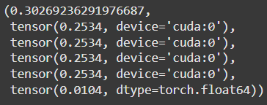
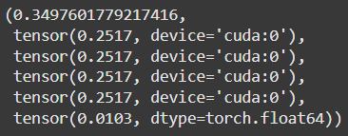
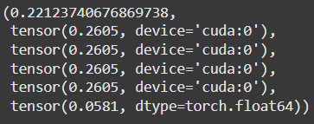
Experimental Results (contd.)
Results
Multilingual Morphological Inflection Models | l=1 | l=2
e=10
e=20*
Bad
About the same
A Bit Better
*l=1, e=20 trained with normalized output

Slide 8
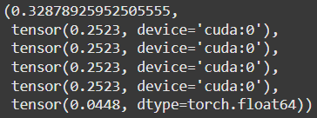
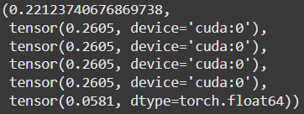
Experimental Results (contd.)
Results
Multilingual Morphological Inflection Models (“Normalized”) | l=1
e=10
e=20
Basically correct but affects accuracy
A Bit Better
Same

Slide 9
Experimental Results (contd.)
Results
Language Classification Model | l=1, e=10
Loss | 1.057
Accuracy | 0.986
Precision | 0.986
Recall | 0.986
Awesome!
Awful!
Lang | Train Acc | Valid Acc
Eng | 0.43 | 0.43
Heb | 0.41 | 0.33
Hun | 0.39 | 0.39
Rus | 0.25 | 0.25
Spa | 0.41 | 0.44
Tur | 0.36 | 0.34

Slide 10

Experimental Results (contd.)
Findings
Learning inflections is hard…
Accuracy low, but mostly due to minor misspellings
H
Should be “gowling” and “fustigated”
Can be solved by training longer or applying an “autocorrect” after inference
Straight-through gradient estimation for hard attention may also be helpful

Slide 11
Potential Applications for Machine Translation
Lang
Data
Glossed
Data
(gloss, infs)
Glosser
Went → Go;PST
NMT Unit
MI Unit
NMT Output
Cross-Reference
MI Outputs
Nuanced NMT Output

Slide 12
Thank You!

